Slide 1
MODULE : RESPIRATORY SYSTEM
By Dr KWIZERA NDEKEZI Jackson

Slide 2
OBJECTIVES
Having successfully completed the module, students should be able to demonstrate knowledge and understanding of:
In relation to basic sciences:
1. The normal structure and function of the different parts of the respiratory system;

Slide 3
In relation to Pulmonology:
2. Current diseases of the respiratory system: epidemiology, etiology, pathogenesis, pathological physiology, clinical signs and symptoms, laboratory, functional testing and X-ray findings, treatment, evolution, prognosis, and complications.

Slide 4
In relation to chest and lung surgery:
3. Thoracic trauma, lung and pleural lesions.

Slide 5
The student will be able to discuss medical terms commonly used in the respiratory system.
Review and identify anatomical structures on the respiratory system
Explain respiratory physiology in relation to respiratory anatomy and the normal respiratory patterns

Slide 6
Respiratory Tract Infections
By Dr KWIZERA NDEKEZI Jackson

Slide 7
Pulmonary infections
Upper airways
Bronchitis
Acute
Chronic
Pneumonia
Community acquired
Nosocomial
Immunocompromised
Tuberculosis

Slide 8
Acute tracheobronchitis
Definition:
An inflammatory condition of the tracheobronchial tree associated with generalized respiratory infection.

Slide 9
Acute laryngotracheitis
Symptoms
Cough, dry, whooping, unrelentingness(never-ceasing)
Vague pain over trachea
Hoarse
Agents:
As in acute bronchitis
Treatment: symptomatic

Slide 10
Whooping = Cough spasmodically(A painful and involuntary muscular contraction)
"The patient with emphysema is whooping all day"
Hoarse = Deep and harsh sounding as if from shouting, illness or emotion

Slide 11
Acute Bronchitis
Clinical Presentation
Cough
Fever +/-
Hoarseness
Sputum production
Substernal pain
Rhonchi/coarse rales
No evidence of consolidation

Slide 12
Rhonchi = A sound like whistling or snoring that is heard with a stethoscope during expiration as air passes through obstructed channels
_{rhonchus, pl. rhonchi}
_{rongck\s, rongckU}
an added sound with a musical pitch occurring during inspiration or expiration, heard on auscultation of the chest, and caused by air passing through bronchi that are narrowed by inflammation, spasm of smooth muscle, or presence of mucus in the lumen; if low-pitched, it is called sonorous rhonchus; if high-pitched, with a whistling or squeaky quality, sibilant rhonchus.
_{Origin}
[L. fr. G. rhenchos, a snoring]

Slide 13
Acute bronchitis
Viral
(Para-)influenza
Respiratory Syncitial
Coxsackie
ECHO
Corona
Droplet
Whole year
Exacerbation asthma/COPD
Bacteria
Secondary
Moraxella catarrhalis
Hemophilus I
Streptococ P

Slide 14
Acute Bronchitis
Respiratory viruses are common pathogens in acute bronchitis¹
Respiratory virus infection associated with cough¹
Influenza virus: 75%–93% of cases
Adenovirus: 45%–90%
RVs: 32%–60%
Coronavirus: 10%–50%
40% of nonasthmatic patients with acute bronchitis had FEV₁ ≤80% of predicted²
Bronchial reactivity remained increased up to 5 weeks after episode of acute bronchitis^{2,3}
1. Gwaltney JM Jr. In: Mandell GL, Bennett JE, Dolin R, eds. Principles and Practice of Infectious Diseases. 5th ed. Philadelphia: Churchill Livingstone; 2000:703. 2. Williamson HA Jr. J Fam Pract. 1987;25:251.
3. Hallett JS, Jacobs RL. Ann Allergy. 1985;55:568.
Notes:
Respiratory viruses are common pathogens in acute bronchitis.¹ Cough is caused by all major respiratory viruses and is a localizing symptom of the respiratory tract associated with infection with influenza virus in 75% to 93% of cases, with adenovirus in 45% to 90%, with RVs in 32% to 60%, and with coronavirus in 10% to 15%.¹
A study was conducted to determine whether an obstructive pattern on pulmonary function tests might suggest occult bronchospasm in nonasthmatic patients with acute bronchitis.² This study found an FEV₁ ≤80% of predicted in 41% of adults presenting with acute bronchitis who had no prior history of lung disease.
Other studies have shown bronchial reactivity to be increased for as long as 5 weeks after an uncomplicated episode of bronchitis in otherwise healthy adults.^{2,3}
1. Gwaltney JM Jr. Acute bronchitis. In: Mandell GL, Bennett JE, Dolin R, eds. Principles and Practice of Infectious Diseases. 5th ed. Philadelphia, Pa: Churchill Livingstone; 2000:703-706.
2. Williamson HA Jr. Pulmonary function tests in acute bronchitis: evidence for reversible airway obstruction. J Fam Pract. 1987;25:251-256.
3. Hallett JS, Jacobs RL. Recurrent acute bronchitis: the association with undiagnosed bronchial asthma. Ann Allergy. 1985;55:568-570.

Slide 15
diagnosis
Clinical
Sputum culture if coloured

Slide 16
Acute Bronchitis
Treatment
Symptomatic relief of cough
dextromethorphan, codeine, hydration
Antibiotic therapy only if pneumonia present

Slide 17
Chronic Bronchitis
Definition
Coughing up colorless sputum on most days during 3 consecutive months for more than 2 consecutive years.
Seen often with COPD, asthma and smoking.

Slide 18
Acute Exacerbations of Chronic Bronchitis (AECB)
Clinical Presentation
Increased cough
Dyspnea
Chest tightness
Increased fatigue
Increased sputum production
change in color and/or amount

Slide 19
AECB: Etiology
Infectious, 80%
Bacterial pathogens, 40%–50%
Viruses, 30%–40%
Atypical bacteria, 5%–10%
Noninfectious, 20%
Environmental factors
Noncompliance with medical therapy
Sethi S. Chest. 2000;117(suppl):380S.
Notes:
COPD is characterized by intermittent AECB associated with worsening symptoms and lung function.
The three classes of pathogens that infect the lower respiratory tract—gram-positive and gram-negative bacteria, viruses, and atypical bacteria—are a major etiologic factor in AECB. The relative contribution of these different classes of pathogens may change depending on the severity of the underlying disease.
Predominant bacterial species isolated from sputum of those with AECB are nontypeable Haemophilus influenzae, Moraxella catarrhalis, and Streptococcus pneumoniae. Whether these organisms represent true infection or simply colonization of the lower airway is a subject of controversy.
Also controversial is the role of viral pathogens as a cause of acute exacerbations. Although 30% to 40% of exacerbations are caused by viruses, this may be an underestimation because of the difficulty in isolating and identifying these viruses.
Sethi S. Infectious etiology of acute exacerbations of chronic bronchitis. Chest.
2000;117(suppl):380S-385S.

Slide 20
AECB
Diagnosis
Sputum culture
Absence of infiltrate on CXR

Slide 21
AECB
Treatment
Antibiotic therapy for 7-10 days for acute infectious exacerbations
TMP/SMX
Doxycycline 100 mg BID
Amoxicillin Clavulanate 875/125 BID
Clarithromycin 500 mg BID
Azithromycin 500 mg x 1; 250 QD x 4
Levofloxacin 500 mg QD
Systemic steroids

Slide 22
AECB
Prophylactic therapy
Patients should receive annual influenza vaccination.
Streptococcus pneumoniae vaccination (x1, revaccinate if >5yrs since vaccination and age <65 at time of first vaccination)
Intermittent antibiotics (i.e. first week of month during winter months).

Slide 23
Pneumonia
Respiratory Tract Defenses
Anatomical/mechanical
Mucociliary clearance
Cough
Cellular Defenses
Pulmonary macrophages
Pulmonary lymphocytes
Humoral Defenses(Of or relating to bodily fluids)
IgA (IgG, IgM)

Slide 24
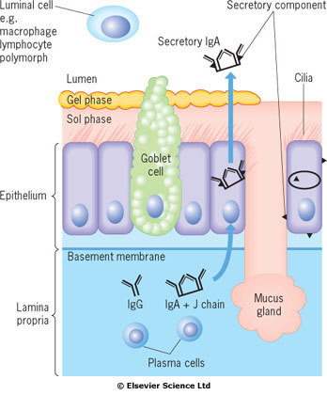

Slide 25
Pneumonia
Alteration in host defenses
Altered consciousness
stroke, seizure, anesthesia, alcohol abuse
Cigarette smoke
decreased mucociliary function
Increasing age
Immunocompromised
CA, AIDS, Steroids

Slide 26
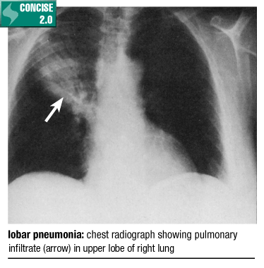

Slide 27
Pneumonia
Organism
Virulence
Quantity
Transmission
Aerosolized droplets
Droplet size

Slide 28
Pneumonia
Clinical Presentation
Fever
Increased WBC
Dyspnea
Productive cough
Increased respiratory rate
Chest X-ray infiltrate/consolidation
Rales/ronchi

Slide 29
Pneumonia: Community Acquired
Common pathogens
S. pneumoniae
H. influenzae
M. pneumoniae
Viruses
C. pneumoniae
Legionella pneumophila

Slide 30
Pneumonia: Aspiration
Common pathogens
Mixed flora
Mouth anaerobes
Peptostreptococcus spp, Actinomyces spp
Stomach contents
Chemical pneumonitis
Bacterial infections

Slide 31
Pneumonia: Hospital Acquired
Common pathogens
Gram negative organisms
Klebsiella pneumoniae, E. coli, Serratia marcescens, Proteus mirabilis
Pseudomonas aeruginosa
ICU, immunocompromised, ventilator

Slide 32
Pneumonia
Diagnosis
Chest X-ray: consolidation
Sputum gram stain
Good specimen
WBC’s
Few epithelial cells
Single predominant organism
Blood cultures (septicemia)

Slide 33
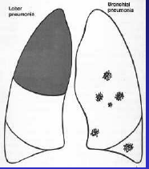
radiology

Slide 34
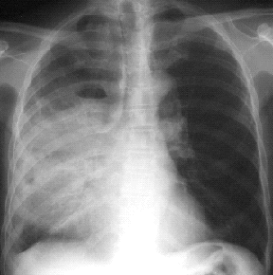

Slide 35
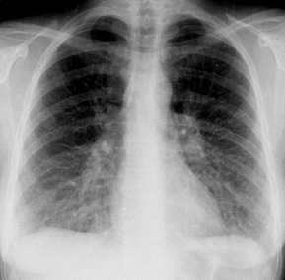

Slide 36
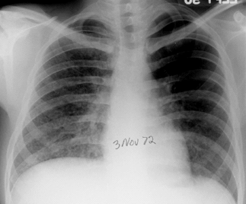

Slide 37
Pneumonia
Gram stain
Organisms not visible on gram stain
M. pneumonia
Legionella pneumophila
Viruses
Common organisms
Gram positive diplococci (pairs and chains)
Gram positive clusters
Gram negative coccobacillary (pleomorphic)
Gram negative rods
‘atypical pneumonia’

Slide 38
Mycoplasma pneumoniae
Pathogen with rigid cell wall
Children & young adults
Outbreaks every 4 years
Starts typically with URTI followed by pneumonia in 30% of cases
Associated immunological syndromes
Meningo-encephalitis
Neuropathy
Rashes
Arthralgia(Pain in a joint or joints)
Hepatitis
Splenomegaly
R/ macrolide or doxycycline

Slide 39
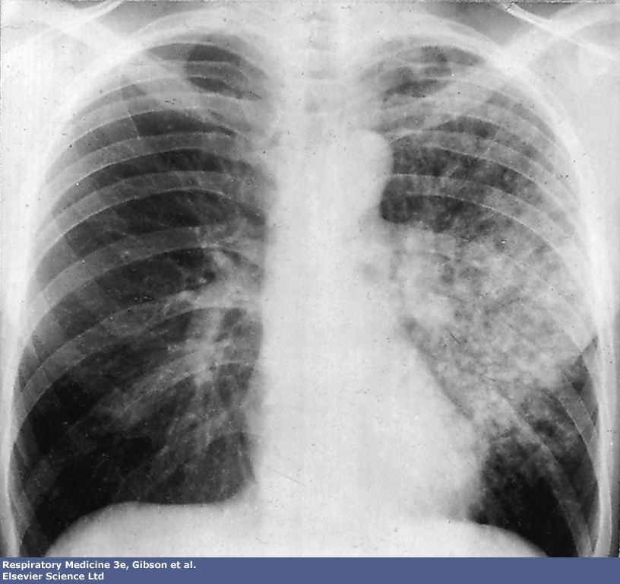

Slide 40
Streptococcus pneumoniae
Diplococ, gram stain +
Cause of 60% of CAP and 15% of HAP
Serotype responsible for virulence
Clinical picture
Sudden onset, severely ill
Rosty sputum
Consolidation on CXR
Hyperleucocytosis
Beware of
Septicemia
Postsplenectomy
R/ penicillin unless high local antibiotic resistance: amoxiclav

Slide 41
Chlamydia pneumonia
3 species
Pneumoniae: outbreaks; starts with URTI
Psittaci: ornithosis: contact with (exotic) birds
Trachomatis: infants; transmitted during birth
R/ doxycycline

Slide 42
Legionella pneumonia
Legionella pneumophilia
Grows in heated water: tanks, airco, pools
No person to person transmission
Transmitted by contaminated water sources: outbreaks in hotels, exhibitions, conventions
Sporadic cases
Severe pneumonia with prostration, confusion, abdominal symptoms
High mortality
Diagnosis: IF of sputum or urine
R/ macrolide, rifampicin

Slide 43
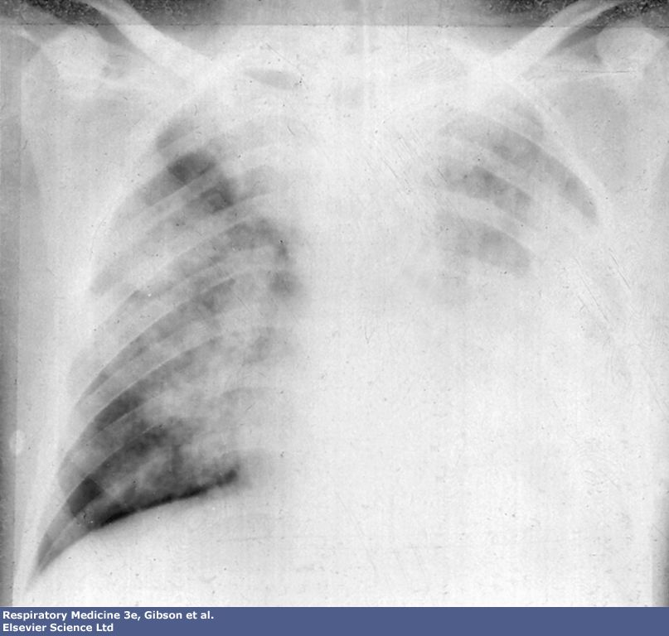

Slide 44
Hemophilus Influenzae pneumonia
Gram negative bacillus
6 capsulated serotypes, B most virulent
Uncapsulated serotypes responsible for AECB and bronchopneumonia in pts with COPD/asthma
R/ amoxiclav, TMP-SMX, cefuroxime

Slide 45
Pneumonia
General Care
Hydration
Nutrition
Antipyretics/analgesics
oxygenation
Ventilation

Slide 46
Severe pneumonia
Clinical
RR > 30/min
Systolic BP < 90 mm Hg
Diastolic BP < 60 mm Hg
Age > 60
Comorbidity (cardiac, COPD, diabetes, ...)
Acute confusion
Radiological: multilobar involvement
Laboratory
Hypoxemia: PO2 < 60 mm Hg
Hyper or hypo leucocytosis (> 20.000/ < 4000)
Serum urea increase
Bacteremia

Slide 47
CAP
Outpatient treatment of community acquired Pneumonia
Prediction rule to identify low risk patients for assignment of outpt. vs inpt. treatment

Slide 48
Pneumonia
Empiric antimicrobial therapy
Aimed at most likely pathogens
Depends on patient’s underlying disease and where infection acquired.
Duration of therapy
7-14 days

Slide 49
Empirical therapy- CAP
Sudden onset, clinical picture of pneumococcal infection: peni/ampi/amoxiclav
Aspiration: Amoxicillin/Clavulanate
Young adult: macrolide or doxycycline
Alternatives: cefuroxime

Slide 50
Community Acquired Outpatient Treatment
Macrolide, doxycycline or fluoroquinolone
Alternative: (Not active against atypical pathogens)
Amoxicillin/clavulanate, second generation cephalosporin
If young adult (17-40) doxycycline

Slide 51
Community Acquired Inpatient Treatment General Medicine Ward
2 or 3 generation Cephalosporine with or without a macrolide or doxycycline
Or
Fluoroquinolone alone

Slide 52
Empyema
Definition
Collection of pus in a cavity, hollow organ or space
Complication of pneumonia
Complication of surgery

Slide 53
Empyema
Clinical Presentation
Similar to pneumonia
Chest X-ray
Blunting of costophrenic angles
CT

Slide 54
Empyema
Treatment
Thoracocentesis
Chest tube(s)
Antibiotics

Slide 55
Lung Abscess
Definition
Pulmonary infection involving the destruction of the lung parenchyma to produce cavities with an air-fluid level.

Slide 56
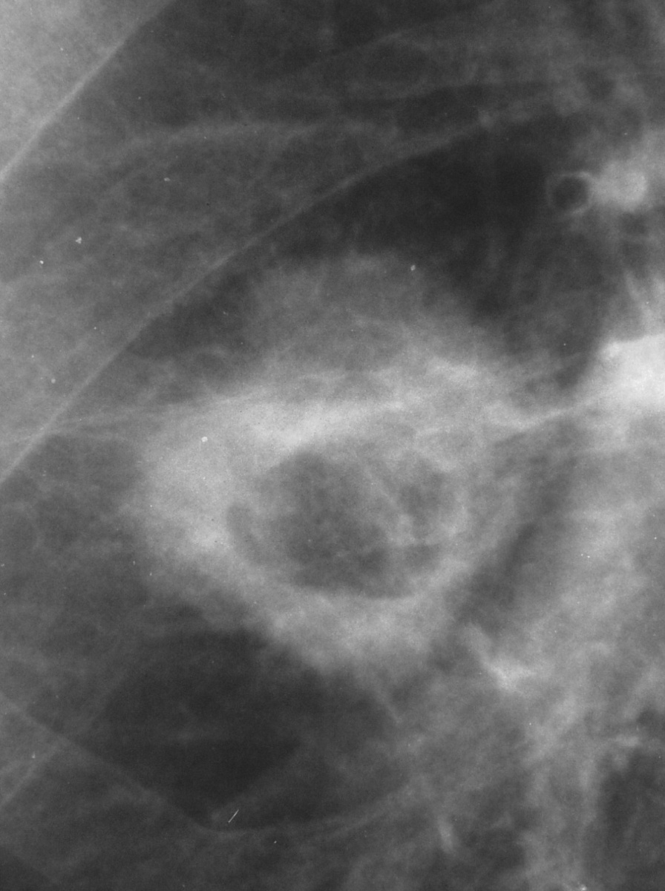
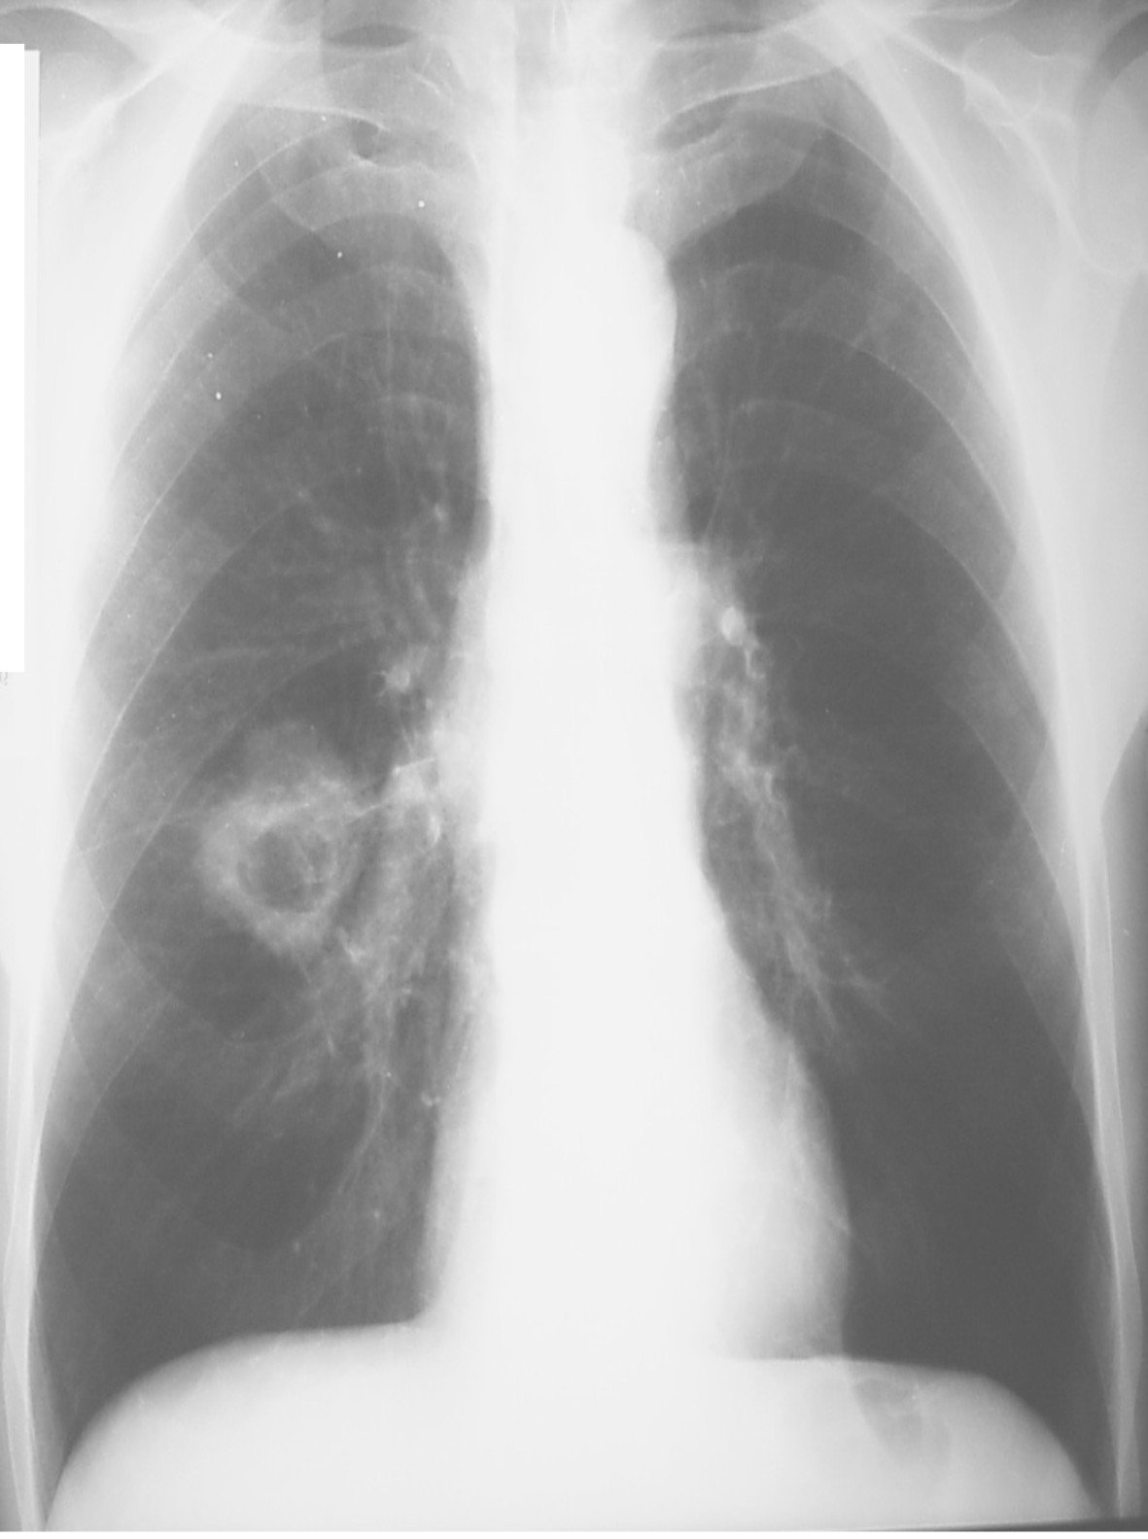
Notes:
thorax.rx.bronchusCA11.necrose.ddabces tbc

Slide 57
Lung Abscess
Risk Factors
Aspiration
Periodontal disease/gingivitis
Periodontal(involving gums and other structures around the teeth)

Slide 58
Lung Abscess
Common Pathogens
Bacteroides melanogenicus
Fusobacterium nucleatum
Gram positive anaerobes
S. aureus
Enteric gram negative organisms

Slide 59
Lung Abscess
Clinical Presentation
Slow onset with generalized symptoms

Slide 60
Lung Abscess
Treatment
Penicillin plus Clindamycin or Metronidazole
3rd gen. Cephalosporin plus Clindamycin or Metronidazole
Duration: 2-4 months

Slide 61
Bronchiectasis Pulmonary complications in immunocompromised host

Slide 62
Bronchiectasis: definition
Chronic disease characterised by an irreversible dilatation of bronchi caused by bronchial wall damage resulting from infection and inflammation
Usually accompagnied by chronic purulent sputum production

Slide 63
pathogenesis
Any lesion to bronchial mucosa causes disruption of the mucociliary escalator and direct adhesion of bacteria to the epithelium
Epithelial repair involves the spreading, migration and proliferation of epithelial cells by the synthesis of
fibronectin (cell migration)
Integrin (cell-cell adhesion)

Slide 64
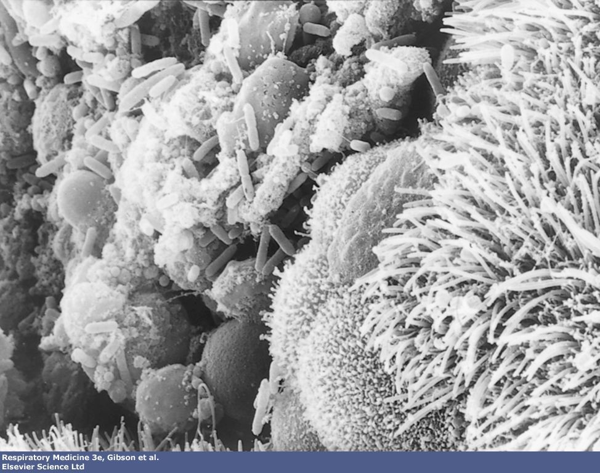

Slide 65
pathogenesis
The receptors on the epithelial cells for integrin and fibronectin are used by outer membrane proteins of certain bacteria as sites of bacterial adherence
Accumulation of secretions
Persistent infection leads to inflammation
Tissue damage by proteases
Dilatation of bronchus
Vicious circle

Slide 66
causes
Severe infection
Bacterial pneumonia (S aureus, pseudomonas, klebsiella)
Aspiration pneumonia (recurrent)
Tbc
Bronchial obstruction
Foreign body (peanut)
Cancer
Immunodefiency status
Hypogammaglobulinemia
Other acquired
ciliary dyskinesias

Slide 67
Clinical picture
Generalized or localized in mostly lower lobes
Chronic cough productive of large amounts of purulent sputum
Complications:
(severe) hemorrhage
Severe pneumonia-empyema
Weight loss, malaise
Halitosis(_{a foul odor of the breath.})
Clubbing
Secondary abscesses

Slide 68
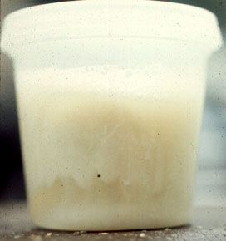
3 Layered sputum

Slide 69
diagnosis
CXR
CTscan
Bronchoscopy
Sputum cultures
HI & pneumococcus
SA
Pseudomonas
Moraxella
...

Slide 70
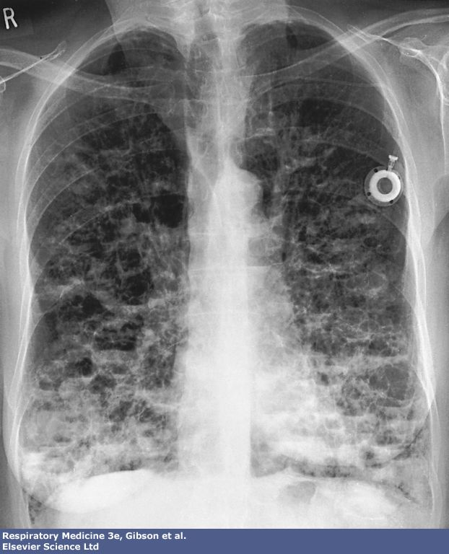

Slide 71
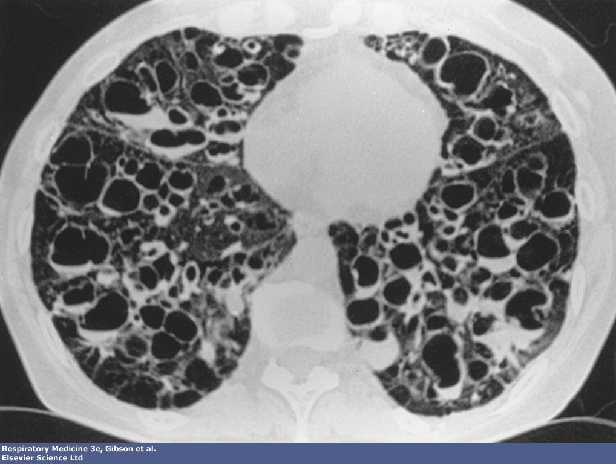

Slide 72
treatment
Causal
Chest physiotherapy
Antibiotics: high doses
At exacerbations guided by cultures
Intermittent macrolides?
Bronchodilators
Resection if localized
Vaccination pneumoccus and influenza (?)

Slide 73
Pulmonary complications in ICH
HIV: cellular immunity
Prevalence in Rwanda: 13%
Cancer
Immunosuppressive therapy
Post transplant

Slide 74
HIV & lung
Infectious bronchitis/pneumonia
Bacterial: SP, HI, Pseudomonas
Tbc: primary and miliary
Opportunistic
Fungal: PCP, Aspergillus fumigatus, Candida
Viral: CMV, HSV
Mycobacterial: MAIC
Neoplastic
Kaposi sarcoma, lymphoma, lung cancer
Inflammatory: interstitial pneumonitis

Slide 75
PCP
Pneumocystis carinii
Fungus
Ubiquitous
Causes disease when CD4 T-lymhocyte count <200/ µl
Symptoms of rapidly progressing severe pneumonia with respiratory insufficiency

Slide 76
diagnosis
Suspicion!
CXR
PC on silver stain or IF of induced sputum or BAL-fluid

Slide 77
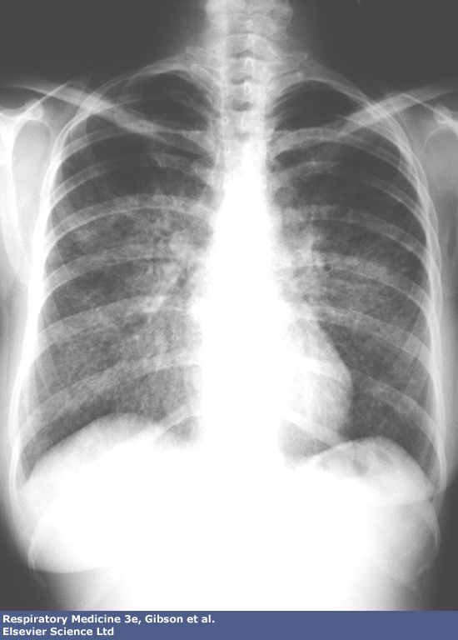

Slide 78
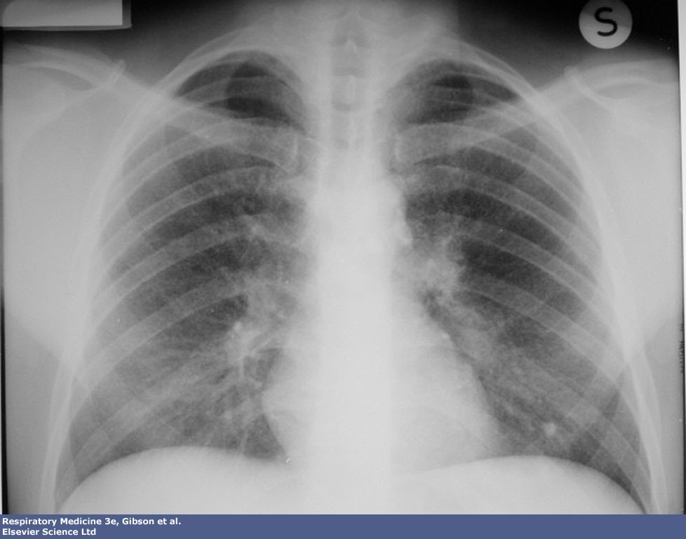

Slide 79
Treatment
High mortality if not adequately treated
High dose TMP-SMX for 3 weeks
Orally or iv
Side-effects
Inhalation of pentamidine
Systemic steroids in severe cases

Slide 80
PULMONARY TUBERCULOSIS

Slide 81
General Considerations
Tuberculosis is a chronic infection,
potentially of lifelong duration, caused
by two species of mycobacteria M.tuberculosis and, rarely, M.bovis.
It was isolated by Robert Koch in 1882
The morbidity and mortality of tuberculosis are high in developing countries.

Slide 82

General Considerations
The disease is confined to the lungs in most patients but may spread to almost
any part of the body.

Slide 83

Etiology
The tubercle bacillus ( M.Tuberculosis ) is
aerobic , non-motile, non-spore-forming, high
in lipid content, and acid and alcohol-fast
It grows slowly .
It can’t tolerate heat, but It can live in humid or dry or cold surroundings.

Slide 84
Epidemiology
A key link of epidemic
The source of contagious
The route of spread
Peoples of easily affected

Slide 85
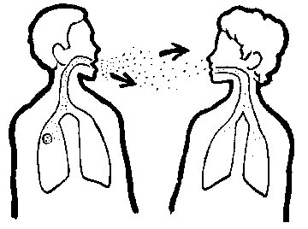
Tuberculosis is transmitted by airborne droplet nuclei (containing tubercle bacilli )

Slide 86
Many droplet nuclei are capable of floating (suspended in a liquid) in the immediate environment for several hours.
Large particles may be inhaled by a person breathing the same air and impact on the trachea or wall of the upper airway.

Slide 87
The transmission is determined
The probability of contact with a case of TB
The intimacy and duration of that contact
The degree of infectiousness of case
The shared environment of the contact

Slide 88
Pathogenesis
tubercle bacillus
Human immunity

Slide 89
Human Immunity after infected tubercle bacillus and tuberculin hypersensitivity
The natural immunity of human to TB is nonspecific
After infected or given BCG vaccine, human will obtain specific immunity
The immunity of tubercle bacillus is cell- mediated immunity

Slide 90
Two types of cells are essential
Macrophages: directly phagocytize TB and processing and presenting antigens to T lymphocyte.
T lymphocytes(CD4+): induce protection through the production of lymphokines.

Slide 91
Lymphokines = A cytokine secreted by helper T cells in response to stimulation by antigens and that acts on other cells of the immune system (as by activating macrophages).
Cytokine = Any of various protein molecules secreted by cells of the immune system that serve to regulate the immune system.

Slide 92
Koch phenomenon
It refers that there are different reactions to TB infection between primary and secondary infection.

Slide 93
During the course of TB, there are three basic pathologic changes
Including infiltration, hyperplasia, ulceration
or calcification.
These changes happen in different stage of
tuberculosis.
When host defense is destroyed and there is
much more bacteria, caseating ulceration
will exist.
Otherwise, when host defense is predominant
and there is less bacteria, perhaps hyperplasia
and calcification will happen.

Slide 94
Clinical Manifestations
systemic signs:
Most patients present as cases of pulmonary tuberculosis
with fever, weight loss, anorexia, fatigue, night sweats
wasting.
respiratory signs:
Cough may vary from mild to severe, and sputum may be
scant and mucoid or copious and purulent.
Hemoptysis may be due to cough of a caseous lesion or
bronchial ulceration
chest pain, tachypnea…
Physical signs: nonspecific.

Slide 95
Diagnosis of disease
Medical history
Screening
Physical examination
Chest radiograph
Bacteriologic exam
AFB
Culture

Slide 96
Medical History
Symptoms of disease
History of TB exposure, infection, or disease
Past TB treatment
Demographic risk factors for TB
Medical conditions that increase risk for TB disease

Slide 97
Medical History
High prevalence population
More likely to be exposed to and infected with bacillus
Immigrant from high prevalence area
Resident or worker in jail
Long term care facility
Close contact to patient with active TB

Slide 98
Jail = A correctional institution used to detain persons who are in the lawful custody of the government (either accused persons awaiting trial or convicted persons serving a sentence).

Slide 99
Medical History
High risk population
More likely to progress from infection to active TB
HIV (+) or other immunodeficiency
CRF
DM
Alcoholics
Malnourished
Malignancy
Gastrectomy

Slide 100
Screening for prior infection
Whom to screen
High prevalence and high risk population (HIV)
How to screen
Mantoux tuberculin test (i.e., purified protein derivative or PPD, tuberculin skin test)
How to interpret
Determine maximum diameter of induration by palpation.

Slide 101
Induration = Any pathological hardening or thickening of tissue.

Slide 102
Mantoux Tuberculin Test
Preferred method of testing for TB infection in adults and children.
Tuberculin skin testing useful for
Examining person who is not ill but may be infected
Determining how many people in group are infected
Examining person who has symptoms of TB.

Slide 103
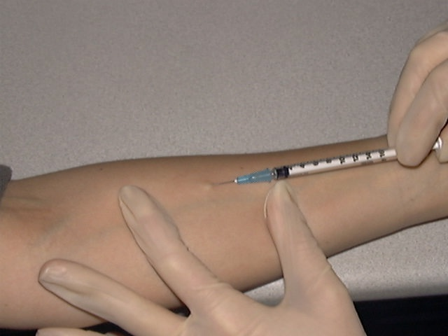
Mantoux test
Injected intradermally
Produce wheal 6 mm to 10 mm in diameter
Represent DTH (delayed type hypersensitivity).

Slide 104
A reaction of less than 5 mm is considered
negative.
• 5-9 mm is considered positive (+)
• 10-19 mm is considered positive (++)
• more than 20 mm is considered positive
(+++)
A positive tuberculin skin test indicates
tuberculous infection, with or without disease.

Slide 105
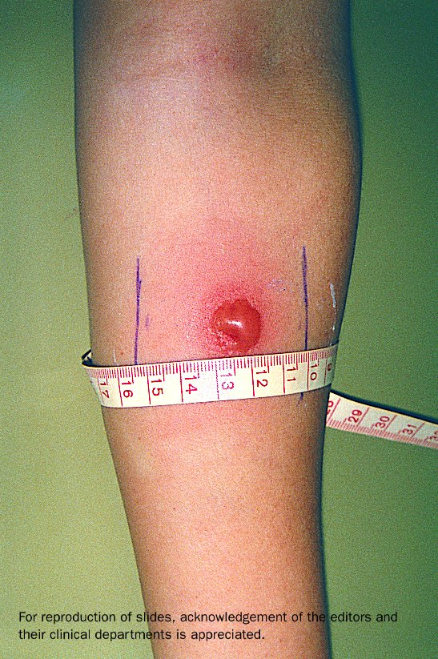

Slide 106
Physical Examination
Productive, prolonged cough
duration of ~3 weeks‏
Chest pain
Hemoptysis
Fever/Chills
Night sweats
Appetite loss
Weight loss
Easily fatigued

Slide 107
Chest radiography
Classical radiograph appearance
Infiltration
Cavitation
Fibrosis with traction
Enlargement of hilar and mediastinal lymph node
In reactivation TB
Classically fibrocavitary apical disease
Primary TB
Middle or lower lobe consolidation.

Slide 108
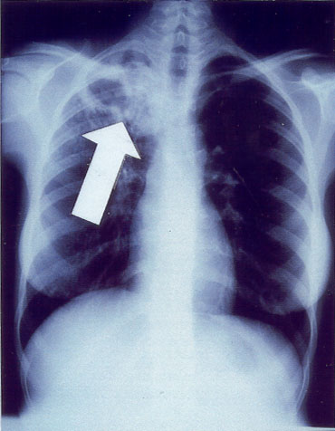
Chest radiography
Abnormalities often seen in apical or posterior segments of upper lobe or superior segments of lower lobe
May have unusual appearance in HIV-positive persons
Cannot confirm diagnosis of TB!!
cavity in patient‘s RUL
classic" for adult-type, reactivation tuberculosis

Slide 109
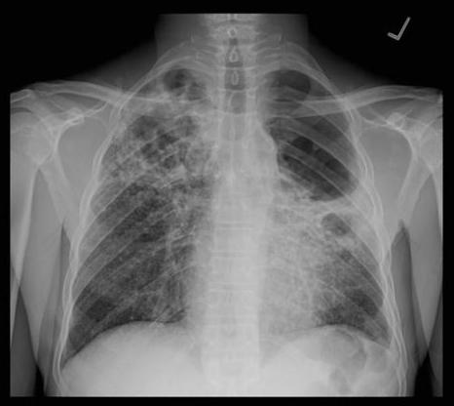
Classic adult TB CXR
PA view
diffuse parenchymal disease with multiple cavities and bulla formation on the left
Sputum smear was positive for AFB.

Slide 110
Chest radiography
No chest X-ray pattern is absolutely typical of TB.
10-15% of culture-positive TB patients not diagnosed by X-ray
40% of patients diagnosed as having TB on the basis of x-ray alone do not have active TB.

Slide 111
X-ray-based evaluation causes over-diagnosis of TB
Over-
diagnosis

Slide 112
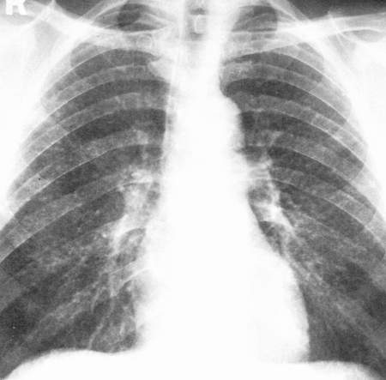
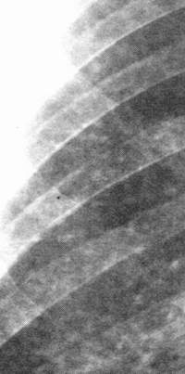
Milliary Tuberculosis
acute milliary tuberculosis

Slide 113
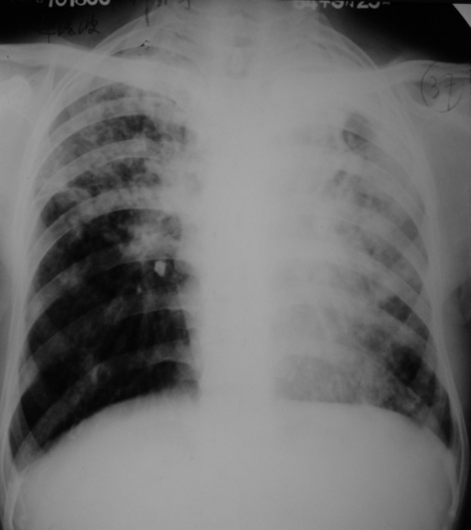
secondary pulmonary tuberculosis
infiltrate

Slide 114
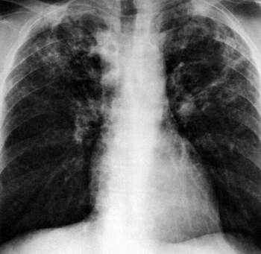
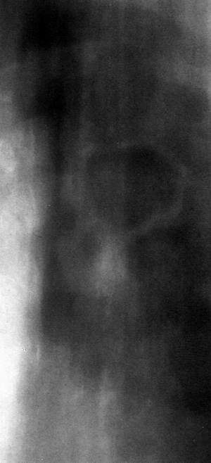
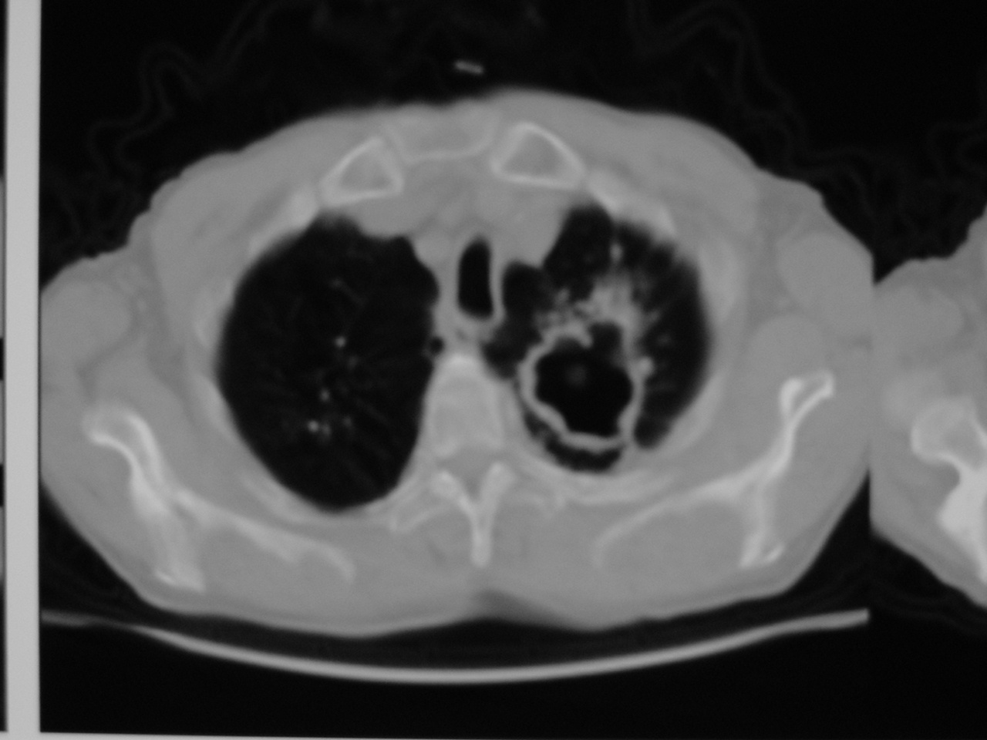
Chronic fibro- cavitary pulmonary tuberculosis
cavity

Slide 115
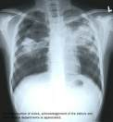

Slide 116
Bacteriologic exam
Obtain 3 sputum specimens for smear examination and culture.
Persons unable to cough up sputum
induce sputum
bronchoscopy
gastric aspiration
Follow infection control precautions during specimen collection.

Slide 117
Three Specimens
Three specimens optimal
Spot specimen on first visit; sputum container given to patient.
Early morning collection by patient on next day.
Spot specimen during second visit.

Slide 118
Number of sputum samples required
overall diagnostic yield for sputum examination related to
the quantity of sputum (at least 5 mL)
the quality of sputum
multiple samples obtained at different times to the laboratory for processing
3 samples obtained at least eight hours apart with at least one sample obtained in the early morning.

Slide 119
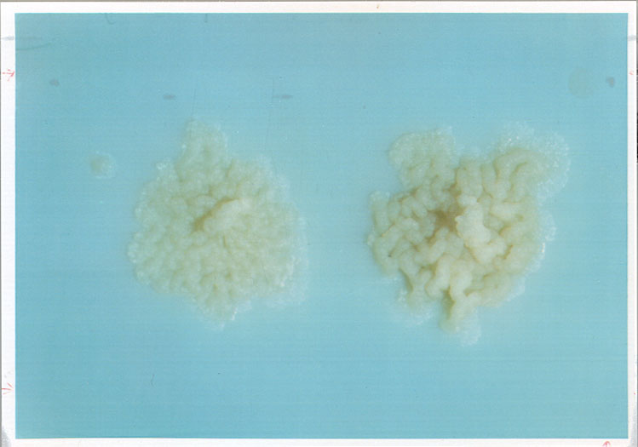
Cultures
Gold standard for TB diagnosis
Used to confirm diagnosis of TB
Culture all specimens, even if smear negative
Results in 4 to 14 days when liquid medium
systems used.
Colonies of M. tuberculosis growing on media

Slide 120
Cultures
Sensitivity: 80-85%
Specificity: 98%
Times needed:
Solid medium
4-8 wks
Liquid medium
2 wks

Slide 121
White blood count and ESR
The white blood cell count is usually normal.
In practice the white blood count is only
useful in a minority of cases, When the
patient is less ill and the radiological
shadowing less extensive the count is
often normal.
ESR is often elevate.

Slide 122
Complications
Pneumothorax
Bronchiectasis
Empyema
Extrapulmonary Spread
Hemoptysis
Chronic pulmonary heart disease

Slide 123
Treatment
The principles of antituberculous chemotherapy involve earlier treatment,
combination, appropriate , regularly and durations.

Slide 124
Treatment
The critical issue in TB control is adopting the DOTS (1995) ( Directly Observed Treatment,
Short-course therapy; DOTS Strategy is recommended by the WHO TB Program.

Slide 125
medicines used to treat tuberculosis are classified as first-line and second-line agents.
First-line essential antituberculous agents are the most effective and are necessary components of any short-course therapeutic regimen.

Slide 126
First-line medicines include
Isoniazid, rifampin(or rifampicin), Ethambutol
pyraziniamide,streptomycine.
Second-line medicines include
Cycloserine, para-amino-salicylic acid,
kanamycin, amikacin and ects.
Newer antituberculous drugs include
rifapentine, rifabutin quinolones…

Slide 127
Isoniazid (INH) first-line drug
Isoniazid is a principal agent used to treat
tuberculosis
It is universally accepted for initial treatment
Now considered the best antituberculous drug
It should be included in all TB treatment
regimens unless the organism is resistant.

Slide 128
Advantages included
Inexpensive
Readily synthesized
Available worldwide
Highly selective for mycobacteria
Well tolerated(about only 5% of patients
exhibiting adverse effects).

Slide 129
Dosage
Tuberculosis organization have recommended 5 mg/kg daily for both groups.
Generally, a 300mg daily oral dose is adopted.

Slide 130
Adverse effects
The two most important adverse effects
of isoniazid therapy are hepatotoxicity
and peripheral neuropathy.

Slide 131
Hepatotoxicity
Isoniazid associated hepatitis is idiosyncratic
and increase in incidence with age.
We must measure liver enzymes before
administrating and during treatment
periods(usually monthly measure).
If the liver enzymes level is higher than
normal , the drug must be discontinued.

Slide 132
Idiosyncrasy = A behavioral attribute that is distinctive and peculiar to an individual.

Slide 133
Peripheral neuritis
It’s associated with isoniazid develops at a
dose-dependent rate of 2 to 20% and probably
relates to interference with pyridoxine metabolism.
This rate can be reduced to 0.2% with the
prophylactic administration of 10 to 50 mg of
pyridoxine daily.

Slide 134
pyridoxine = A B vitamin that is essential for metabolism of amino acids and starch.

Slide 135
Resistance
It is associated with loss of pyrazinamidase activity.
Pyrazinamidase activity is determined by PNCA gene, if PNCA gene is mutated, its activity is lost ( pyrazinamidase )

Slide 136
Rifampin (RFP) first-line drug
It is also considered the most important and potent antituberculosis agent.
Like isoniazid it is bactericidal and highly
effective.
Unlike isoniazid, it is also effective against
most other mycobacteria as well as other
organisms.

Slide 137
Advantage include
It is absorbed after either oral or intravenous
administration.
It has both intracellular and extracellular
anti-bacterial activity.

Slide 138
Dosage
Generally, 10mg/kg, 600mg daily
or twice weekly.
Adverse effects
The most common adverse event
included gastrointestinal upset(Disturb the balance or stability of),hepatitis.

Slide 139
Pyrazinamide (PZA) first-line drug
Pyrazinamide is a major oral agent used
against mycobacteria.
It is an important bactericidal drug used
in short-course therapy for tuberculosis.

Slide 140
Advantage
It is well absorbed after oral administration
The drug is used to kill intracellular tubercle
bacillus.
It is distributed throughout the body,
excellent in CSF.
Dosage
15 to 30 mg/Kg

Slide 141
Adverse effect
At the high dosages, hepatotoxicity is a prominent side effect.

Slide 142
Streptomycin (SM) first-line drug
It is frequently used in developing
country for its lower cost.
It is administered only parenterally,
intramuscular or intravenous.

Slide 143
Dosage
The usual adult dose is 0.5-1.0 g ( 10 to 15 mg/kg)
daily or five times weekly.
The dosage must be lowered and the frequency
of administration reduced(to only
two or three times per week) in most patients
over fifty years old and in any patient with
renal impairment.

Slide 144
Adverse effects
Ototoxity
Renal toxicity
Ototoxic = Toxic to the organs of hearing, balance or to the auditory nerve.

Slide 145
Ethambutol
It is used most often to protect against the
emergency of drug resistance.
Oral administration
The dosage is usually 25 mg/Kg
It will distributes throughout the body except
CSF
Retrobulbar optic neuritis is the most serious
adverse effect.

Slide 146
INH and RFP are the central agent
of any regimen based on their superior
bactericidal activity and low toxicity.
PZA has special utility in promoting
rapid, early reduction in bacillary
burden; in drug-susceptible cases.
PZA need be given only for the initial 2
months to produce this effect.

Slide 147
Initial non-MDR-TB therapy in drug-susceptible disease calls for 8 weeks of therapy with isoniazid, rifampin, pyrazinamide, and ethambutol followed by a continuation regimen of isoniazid and rifampin for 18 more weeks as the most frequent option.
Aggressive treatment is suggested.

Slide 148
Protocol (national)
Primo ttt 2RHZE₇/4RH (every day for 6 months).
Retreatment: 2SRHE/1RHZE/5RHE (every day for 8 months).

Slide 149

Therapy at Each Stage of COPD
I: Mild
II: Moderate
III: Severe
IV: Very Severe
FEV₁/FVC < 70% FEV₁ < 30% predicted or FEV₁ < 50% predicted plus chronic respiratory failure
FEV₁/FVC < 70% 30% < FEV₁ < 50% predicted
FEV₁/FVC < 70% 50% < FEV₁ < 80% predicted
FEV₁/FVC < 70% FEV₁ > 80% predicted
Active reduction of risk factor(s); influenza vaccination
Add short-acting bronchodilator (when needed)
Add regular treatment with one or more long-acting bronchodilators (when needed); Add rehabilitation
Add inhaled glucocorticosteroids if repeated exacerbations
Add long term oxygen if chronic respiratory failure. Consider surgical treatments
Notes:
This provides a summary of the recommended treatment at each stage of COPD.

Slide 150
Chronic obstructive Pulmonary Disease COPD

Slide 151
Cigarette smoking is the primary Cause of COPD.
The WHO estimates 1.1 billion smoker
worldwide, increasing to 1.6 billion by
2025 in low&middle-income countries.
In 2000,the WHO estimated 2.74 million
deaths worldwide from COPD.
In 1990 ,COPD was ranked 12th as burden
of disease,by 2020 it is projected to rank 5th

Slide 152
Definition of COPD
COPD is a preventable and treatable disease with some significant extrapulmonary effects that may contribute to the severity in individual patients.
Its pulmonary component is characterized by airflow limitation that is not fully reversible.
The airflow limitation is usually progressive and associated with an abnormal inflammatory response of the lung to noxious particles or gases.

Slide 153
Noxious = Injurious to physical or mental health
noxious chemical wastes"; "noxious ideas"

Slide 154
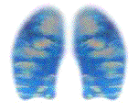
Chronic Obstructive Pulmonary Disease
(COPD)
Chronic bronchitis
Defined as the presence of cough and sputum production for at least 3 months in each of
2 consecutive years, is not necessarily associated with airflow limitation.
Emphysema
Defined as destruction of the alveoli, is a pathological term that is sometimes (incorrectly) used clinically.

Slide 155
_{emphysema}
_{em-fi-sTcm^}
1. presence of air in the interstices of the connective tissue of a part.
2. a condition of the lung characterized by increase beyond the normal in the size of air spaces distal to the terminal bronchiole (those parts containing alveoli), with destructive changes in their walls and reduction in their number. Clinical manifestation is breathlessness on exertion, due to the combined effect (in varying degrees) of reduction of alveolar surface for gas exchange and collapse of smaller airways with trapping of alveolar gas in expiration; this causes the chest to be held in the position of inspiration (“barrel chest”), with prolonged expiration and increased residual volume. Symptoms of chronic bronchitis often, but not necessarily, coexist. Two structural varieties are panlobular (panacinar) emphysema and centrilobular (centriacinar) emphysema; paracicatricial, paraseptal, and bullous emphysema are also common. Syn: pulmonary emphysema.
_{Origin}
[G. inflation of stomach, etc. fr. en, in, + physTma, a blowing, fr. physa, bellows]

Slide 156
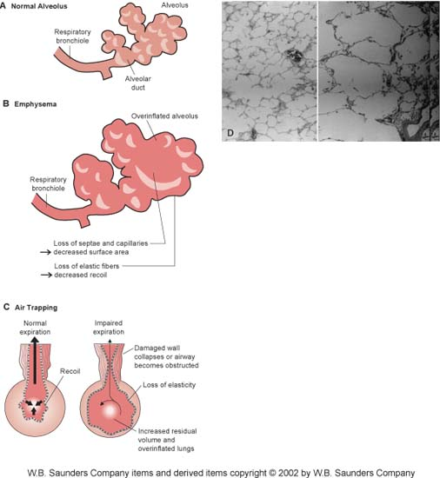

Slide 157
_{residual volume (RV)}
the volume of air remaining in the lungs after a maximal expiratory effort. Syn: residual air, residual capacity.

Slide 158
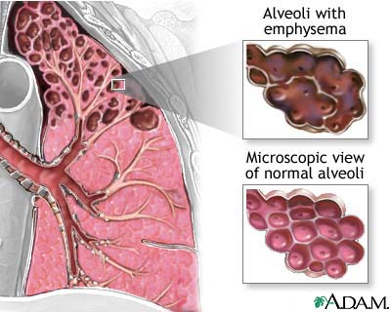

Slide 159
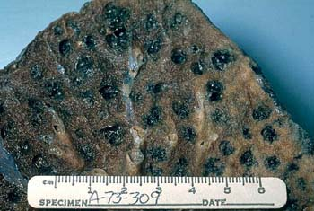

Slide 160
chronic obstructive pulmonary disease (COPD)
general term used for those diseases with permanent or temporary narrowing of small bronchi, in which forced expiratory flow is slowed, especially when no etiologic or other more specific term can be applied.

Slide 161
Classification of COPD Severity
by Spirometry
Stage I: Mild FEV₁/FVC < 0.70
FEV₁ > 80% predicted
Stage II: Moderate FEV₁/FVC < 0.70
50% < FEV₁ < 80% predicted
Stage III: Severe FEV₁/FVC < 0.70
30% < FEV₁ < 50% predicted
Stage IV: Very Severe FEV₁/FVC < 0.70
FEV₁ < 30% predicted or
FEV₁ < 50% predicted plus chronic respiratory failure

Slide 162
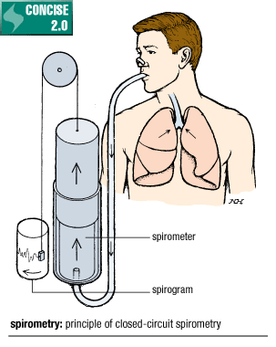
_{spirometry}
_{spU-romc_-trT}
making pulmonary measurements with a spirometer.

Slide 163
Risk Factors for COPD
Exposure to particles
Tobacco smoke
Occupational dusts, organic and inorganic
Indoor air pollution from heating and cooking with biomass in poorly ventilated dwellings
Outdoor air pollution
Gender
Age
Respiratory infections
Socioeconomic status
Nutrition
Comorbidities

Slide 164
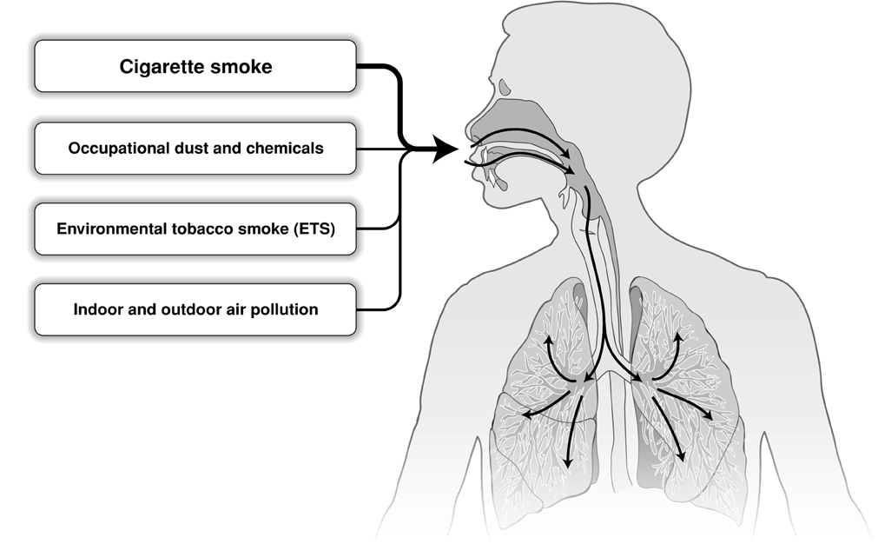
Risk Factors for COPD
Nutrition
Infections
Socio-economic status
Aging Populations

Slide 165
Role of Inflammation in COPD
Inflammation
Small airway disease
Parenchymal destruction
Airflow Limitation

Slide 166
Changes in Pulmonary Arteries in COPD Patients
Endothelial dysfunction
Intimal hyperplasia
Smooth muscle hyperplasia
↑ Inflammatory cells
(macrophages, CD8⁺ lymphocytes)
Source: Peter J. Barnes, MD
Notes:
Changes in pulmonary arteries in COPD patients. There is dysfunction of endothelial cells (reduced vasodilator release), intimal thickening, hyperplasia of smooth muscle and infiltration with inflammatory cells, predominantly macrophages and CD8+ lymphocytes.

Slide 167
Diagnosis Of COPD
The diagnosis should be confirmed by
Spirometry
When performing spirometry, measure:
Forced Vital Capacity (FVC) and
Forced Expiratory Volume in one second (FEV1).
Calculate the FEV1/FVC ratio.
Patients with COPD typically show :
a decrease in both FEV1 and FEV1/FVC
With limited reversibility after bronchodilators

Slide 168
Diagnosis of COPD
EXPOSURE TO RISK
FACTORS
SYMPTOMS
cough
tobacco
sputum
occupation
shortness of breath
indoor/outdoor pollution
è
è
è
SPIROMETRY
Notes:
A diagnosis of COPD should be considered in any patient who has cough, sputum production, or dyspnea and/or a history of exposure to risk factors. The diagnosis is confirmed by spirometry.
To help identify individuals earlier in the course of disease, spirometry should be performed for patients who have chronic cough and sputum production even if they do not have dyspnea.
Spirometry is the best way to diagnose COPD and to monitor its progression and health care workers to care for COPD patients should have assess to spirometry.

Slide 169
A post-bronchodilator FEV₁/FVC < 0.70 confirms the presence of airflow limitation that is not fully reversible.
Where possible, values should be compared to age-related normal values to avoid overdiagnosis of COPD in the elderly.

Slide 170
_{vital capacity (VC)}
the greatest volume of air that can be exhaled from the lungs after a maximum inspiration. Syn: respiratory capacity.

Slide 171
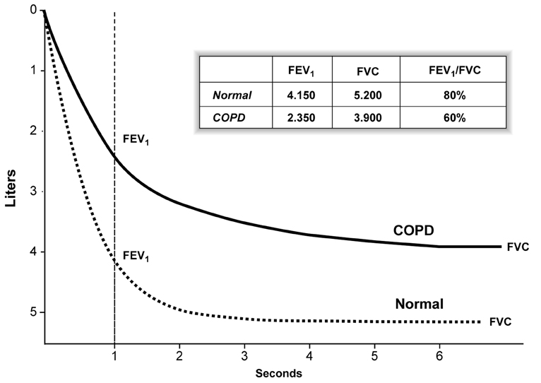
Spirometry: Normal and Patients with COPD

Slide 172
Differential Diagnosis: COPD and Asthma
COPD
ASTHMA
Onset in mid-life
Symptoms slowly progressive
Long smoking history
Dyspnea during exercise
Largely irreversible airflow
limitation
Onset early in life (often childhood)
Symptoms vary from day to day
Symptoms at night/early morning
Allergy, rhinitis, and/or eczema also present
Family history of asthma
Largely reversible airflow limitation

Slide 173
_{eczema}
_{ekcz_-m^}
generic term for inflammatory conditions of the skin, particularly with vesiculation in the acute stage, typically erythematous, edematous, papular, and crusting; followed often by lichenification and scaling and occasionally by duskiness of the erythema and, infrequently, hyperpigmentation; often accompanied by sensations of itching and burning; the vesicles form by intraepidermal spongiosis. Sometimes referred to colloquially as tetter, dry tetter, scaly tetter.

Slide 174
_{bronchospasm}
_{brongckb-spazm}
contraction of smooth muscle in the walls of the bronchi and bronchioles, causing narrowing of the lumen.

Slide 175
COPD and Co-Morbidities
COPD patients are at increased risk for:
Myocardial infarction, angina
Osteoporosis
Respiratory infection
Depression
Diabetes
Lung cancer

Slide 176
COPD and Co-Morbidities
COPD has significant extrapulmonary
(systemic) effects including:
Weight loss
Nutritional abnormalities
Skeletal muscle dysfunction

Slide 177
COPD
FOUR COMPONENT
MANAGEMENT PROGRAM
1. Assess and Monitor Disease 2. Reduce Risk Factors 3. Manage Stable COPD 4. Manage Acute Exacerbations

Slide 178
Management of stable COPD
Patient education.
Pharmacologic Treatment.
- Bronchodilators,
- Glucocorticosteroids,
- Vaccines,
- Antibiotics,
- Mucolytic
- Antitussives,
Non-Pharmacologic Treatment
- Rehabilitation,
- Oxygen Therapy,
- Surgical Treatments(Bullectomy,LVRS,L.T)

Slide 179
Therapy at Each Stage of COPD
I: Mild
II: Moderate
III: Severe
IV: Very Severe
FEV₁/FVC < 70% FEV₁ < 30% predicted or FEV₁ < 50% predicted plus chronic respiratory failure
FEV₁/FVC < 70% 30% < FEV₁ < 50% predicted
FEV₁/FVC < 70% 50% < FEV₁ < 80% predicted
FEV₁/FVC < 70% FEV₁ > 80% predicted
Active reduction of risk factor(s); influenza vaccination
Add short-acting bronchodilator (when needed)
Add regular treatment with one or more long-acting bronchodilators (when needed); Add rehabilitation
Add inhaled glucocorticosteroids if repeated exacerbations
Add long term oxygen if chronic respiratory failure. Consider surgical treatments
Notes:
This provides a summary of the recommended treatment at each stage of COPD.

Slide 180
Extensively-drug resistance TB (XDR)
XDR-TB: MDR-TB+ resistance to one of second line injectables (Am, Km or Cm) + resistance to any fluoroquinolone

Slide 181
MULTI DRUG RESISTANT TUBERCULOSIS

Slide 182
General definitions of resistance
DRUG RESISTANT TUBERCULOSIS
This is defined as disease (usually pulmonary) caused by M Tuberculosis bacilli resistant to one or more antituberculosis drugs. Drug resistance is further classified into “primary” or “acquired” according to history of previous tuberculosis treatment.

Slide 183
Primary resistance
Resistance in cultures from patients with no history of previous tuberculosis treatment.
Secondary or acquired resistance
Resistance from patients with one or more previous tuberculosis treatment episodes

Slide 184
Why INH and Rifampin?
Most potent and bactericidal
Tb can be treated effectively with INH+Rif alone
Mono-resistance to one of them can be treated effectively with a regimen containing the other agent with very low failure rate (2.5-5%).
Failure rate when INH+Rif resistant is 44% in non-HIV and 70% in HIV patients.
Duration required for cure doubles to triples.

Slide 185
Genesis of MDR TB
Resistance is a man-made amplification of a natural phenomenon.
Inadequate drug delivery is main cause of secondary drug resistance.
Secondary drug resistance is the main cause of primary drug resistance due to transmission of resistant strains.

Slide 186
Clinical Manifestations
MDR-TB are or are not clinically distinguishable from drug-susceptible TB at the outset.
Signs, symptoms, and radiological findings are similar initially to drug-susceptible TB.

Slide 187
Reasons to suspect drug resistance are:
A history of previously treated TB in a person presenting with active TB
High community rates of drug resistant TB
Positive HIV status
High likelihood of exposure to nosocomial, prison or community sources of MDR-TB
The infected person is from a country with a high MDR-TB rates
Contacts with persons with MDR-TB
Infected person has received inadequate treatment regimens for >2 weeks
Smears or cultures remain positive despite 2 months of treatment for TB

Slide 188
Clinical factors promoting resistance
Delayed diagnosis and isolation
Inappropriate drug regimen.
Inadequate initial therapy
Incomplete course of treatment
Inappropriate treatment modifications
Adding single drug to a failing regimen
Inappropriate use of chemoprophylaxis
Poor adherence
Failure to isolate MDR TB patients
Failure to employ DOT
Faked drugs

Slide 189
Resistance: Case definition
Mono resistance: TB strains that are resistant to at least one anti-TB first-line drug (R or H or Z or E)
Poly resistance: TB strains resistant to more than one drug other than Rifampicin and Isoniazid combined (eg H and S or H,E and S)
MDR-TB: TB strains resistant to at least Rifampicin and Isoniazid

Slide 190
Chronic Case
The failure of a fully supervised retreatment regimen.
A chronic case has received at least 2 courses of
chemotherapy, and sometimes more than 2
courses (complete or incomplete). Chronic cases
are often, but not always, excreters of MDR bacilli.
Likewise, patients with retreatment failure are more likely to be harboring multidrug resistant organisms.

Slide 191
WHO categories for TB
Category I: NEW CASE, SMEAR-POSITIVE
Category II: RE-TREATMENT (relapse, failure, return after default)
Category III: NEW CASE, SMEAR NEGATIVE OR EXTRAPULMONARY
Category IV: MDR-TB PATIENTS

Slide 192
Outcome definitions
Cultures should be performed monthly
Culture conversion: two negative consecutive TB cultures taken at least 30 days apart
(Rwanda: 1 neg culture + 3 SS- interval of 2wks)
Time to conversion: interval between the date of MDR-TB treatment initiation and the date of the first of two negative consecutive cultures
Conversion date: date of specimen collection of the first of the two consecutive negative cultures taken 30 days apart

Slide 193
Outcome definitions
CURED: patient who has completed treatment according to programme’s protocol and has at least five consecutive negative cultures from samples collected at least 30 days apart in the final 12 months of treatment.
If only one culture is positive during last 12 months, but there is no concomitant clinical evidence of deterioration, a patient may still be considered cured provided that this positive culture is followed by a minimum of three consecutive negative culture taken 30 days apart

Slide 194
Cure
Cure
Conversion
18 months negative
12
–
–
–
–
–
–
–
–
–
–
+ ?
Cured:
Complete treatment with 5 (or more) Neg culture (30 days apart) in the last 12 months.

Slide 195
Treatment Completed
Treatment completed
Conversion
18 months negative
12
–
–
No cultures
Treatment completed:
Complete treatment with less than 5 neg culture (30 days apart) in the last 12 months.

Slide 196
Treatment Failure
Treatment Failure
Conversion
18
12
–
+
–
–
+
Failed:
2 positive out of 5 cultures in the final 12 months of treatment, or any positive in the last three cultures.

Slide 197
Treatment Failure
Treatment Failure
+
–
+
–
+
+
If patient is persistently culture positive and a clinical decision has been made to terminate treatment early
Patient permanently removed from treatment due to drug intolerance will also receive a treatment failure outcome

Slide 198
Treatment Default
Treatment interrupted > 2 month
+
-
+
-
+
+
Patient whose treatment was interrupted for two or more consecutive months

Slide 199
Treatment Default
Conversion
Treatment interrupted > 2 month
+
–
–
Patient whose treatment was interrupted for two or more consecutive months

Slide 200
Treatment Default
Persistent short interruptions
+
-
+
Patients who are removed from treatment by clinician due to persistent short (<2 months) interruptions should also receive a default outcome

Slide 201
Treatment Outcome
Death
Patient who dies for any reason during the course of MDR-TB treatment
Transfer out
Patient who has been transferred to another reporting and recording unit and for whom the treatment outcome is unknown

Slide 202
Usually the initial regimen for MDR-TB will consist of at least 3 TB drugs the patient has not used before (a single drug should never be added) and as many as 6 drugs.
There are detailed dosages and possible options available depending on many factors. Newer guidelines should always be consulted.

Slide 203
If negative before end 6th month:
Injectable phase 6Km-Z₇-Ofx₇-Pto₇-Cs₇
Continuation phase: 14Ofx₇-Pto₇-Cs-Z₇
If negative after the 6th month:
Injectable phase 8Km₆-Z₇-Ofx₇-Pto₇-Cs₇ and then
4Km₃-Z₇-Ofx₇-Pto₇-Cs₇
Continuation phase : 12Ofx₇-Pto₇-Cs-Z₇

Slide 204
MDR-TB References
CDC. (2003). Treatment of TB. American Thoracic Society, Centers for Disease Control and Prevention, and Infectious Disease Society of America. MMWR, 52 (RR-11),1-88.
Lashley, F.R., & Durham, J.D. (Eds.). (2007). Emerging infectious diseases: Trends and issues. 2nd edition. New York: Springer Publishing Co.
Mukherjee, J.S., Rich, M.L., Socci, A. R. et al. (2004). Programers and principles in treatment of multidrug- resistant tuberculosis. Lancet, 363, 474-481.
CDC (2008). Trends in tuberculosis- United States, 2007. MMWR 57, 281-285.
CDC (2005) Guidelines for preventing the transmission of tuberculosis; healthcare settings, 2005. MMWR,54,1-141.
Yew, W.W. and Leung, C.C. (2008) Management of multidrug-resistant tuberculosis: Update 2007. Respirology, 13, 21-46.

Slide 205
Extensively-drug resistance TB (XDR)
XDR-TB: MDR-TB+ resistance to one of second line injectables (Am, Km or Cm) + resistance to any fluoroquinolone

Slide 206

Treatment of exacerbations
Primary therapies for exacerbations:
Repetitive administration of rapid-acting inhaled β₂-agonist
Early introduction of systemic glucocorticosteroids
Oxygen supplementation
Closely monitor response to treatment with serial
measures of lung function

Slide 207
ASTHMA

Slide 208
Definition
Asthma is a chronic inflammatory disorder of the airways in which many cells and cellular elements play a role.
The chronic inflammation is associated with airway hyperresponsiveness that leads to recurrent episodes of wheezing, breathlessness, chest tightness, and coughing, particularly at night or in the early morning.

Slide 209
These episodes are usually associated with widespread, but variable, airflow obstruction within the lung that is often
reversible either spontaneously or with treatment.

Slide 210
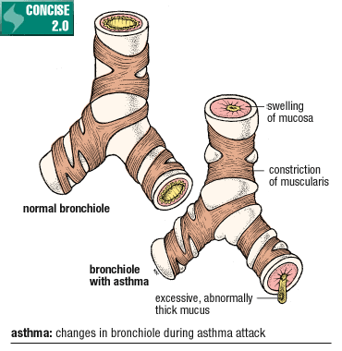
_{asthma}
_{azcm^}
an inflammatory disease of the lungs characterized by reversible (in most cases) airway obstruction. Originally, a term used to mean “difficult breathing”; now used to denote bronchial asthma. Syn: reactive airways disease.

Slide 211
Burden of Asthma
Asthma is one of the most common chronic diseases worldwide with an estimated 300 million affected individuals
Prevalence increasing in many countries, especially in children
A major cause of school/work absence

Slide 212
Risk factors for asthma
Factors that influence the risk of asthma can be divided into those that cause the development of asthma and those that trigger asthma symptoms; some do both.
The former include host factors (which are primarily genetic) and the latter are usually environmental factors.

Slide 213
Factors that Exacerbate Asthma
Allergens
Respiratory infections
Exercise and hyperventilation
Weather changes
Food, additives, drugs

Slide 214
Hyperventilation = An increased depth and rate of breathing greater than demanded by the body needs; can cause dizziness and tingling of the fingers and toes and chest pain if continued

Slide 215
Weather = (meteorology) the atmospheric conditions that comprise the state of the atmosphere in terms of temperature and wind and clouds and precipitation
"they were hoping for good weather"; "every day we have weather conditions and yesterday was no exception"

Slide 216
Factors that Influence Asthma Development and Expression
Host Factors
Genetic
- Atopy
- Airway hyperresponsiveness
Gender
Obesity
Environmental Factors
Indoor allergens
Outdoor allergens
Occupational sensitizers
Tobacco smoke
Air Pollution
Respiratory Infections
Diet

Slide 217
Atopy = 1. An allergic reaction that becomes apparent in a sensitized person only minutes after contact.
2.a genetically determined state of hypersensitivity to environmental allergens. Type I allergic reaction is associated with the IgE antibody and a group of diseases, principally asthma, hay fever, and atopic dermatitis.

Slide 218
Is it Asthma?
Recurrent episodes of wheezing
Troublesome cough at night
Cough or wheeze after exercise
Cough, wheeze or chest tightness after exposure to allergens or pollutants

Slide 219
Pollutants = Waste matter that contaminates the water, air or soil
Allergens = Any substance that can cause an allergy

Slide 220
Diagnosis
A clinical diagnosis of asthma is often prompted
by symptoms such as episodic breathlessness, wheezing, cough, and chest tightness. Episodic symptoms after an incidental allergen exposure, seasonal variability of symptoms and a positive family history of asthma and atopic disease are also helpful diagnostic guides.

Slide 221
Measurements of lung function ( spirometry or peak expiratory flow) provide an assessment of the severity of airflow limitation, its reversibility, and its variability, and provide confirmation of the diagnosis of asthma.
• Measurements of allergic status can help to identify risk factors that cause asthma symptoms in individual patients.

Slide 222
Extra measures may be required to diagnose asthma in children 5 years and younger and in the elderly, and occupational asthma.
For patients with symptoms consistent with asthma, but normal lung function, measurement of airway responsiveness may help establish the diagnosis

Slide 223
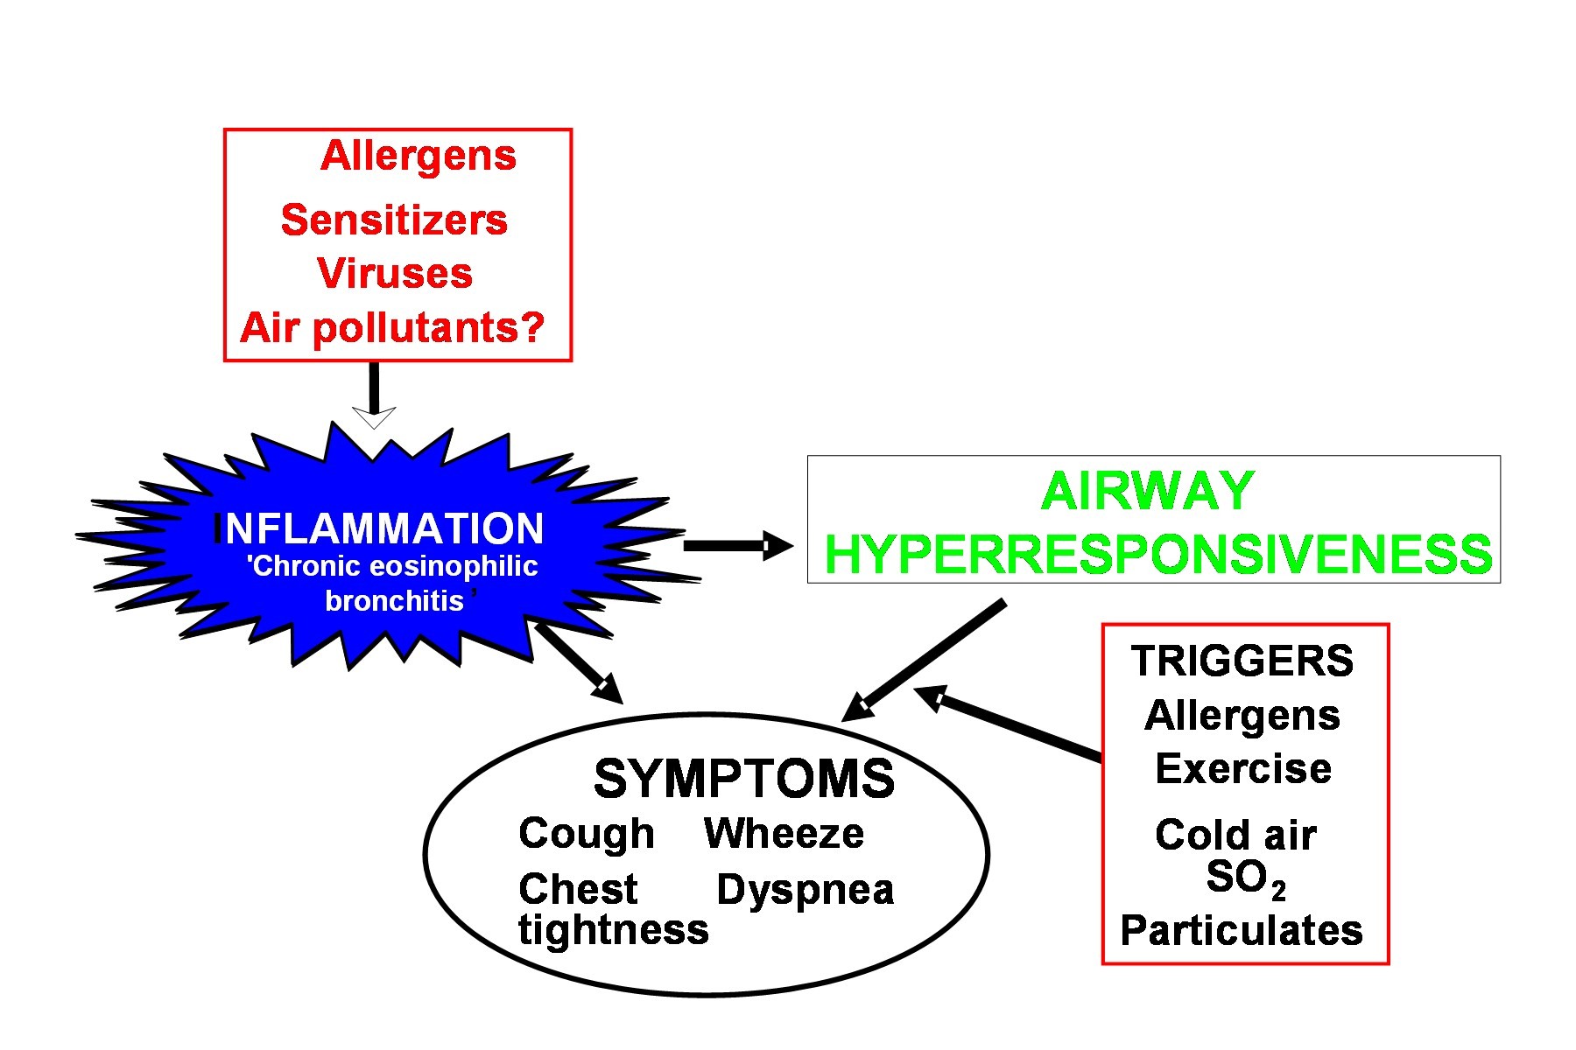
Mechanisms: Asthma Inflammation
Source: Peter J. Barnes, MD

Slide 224
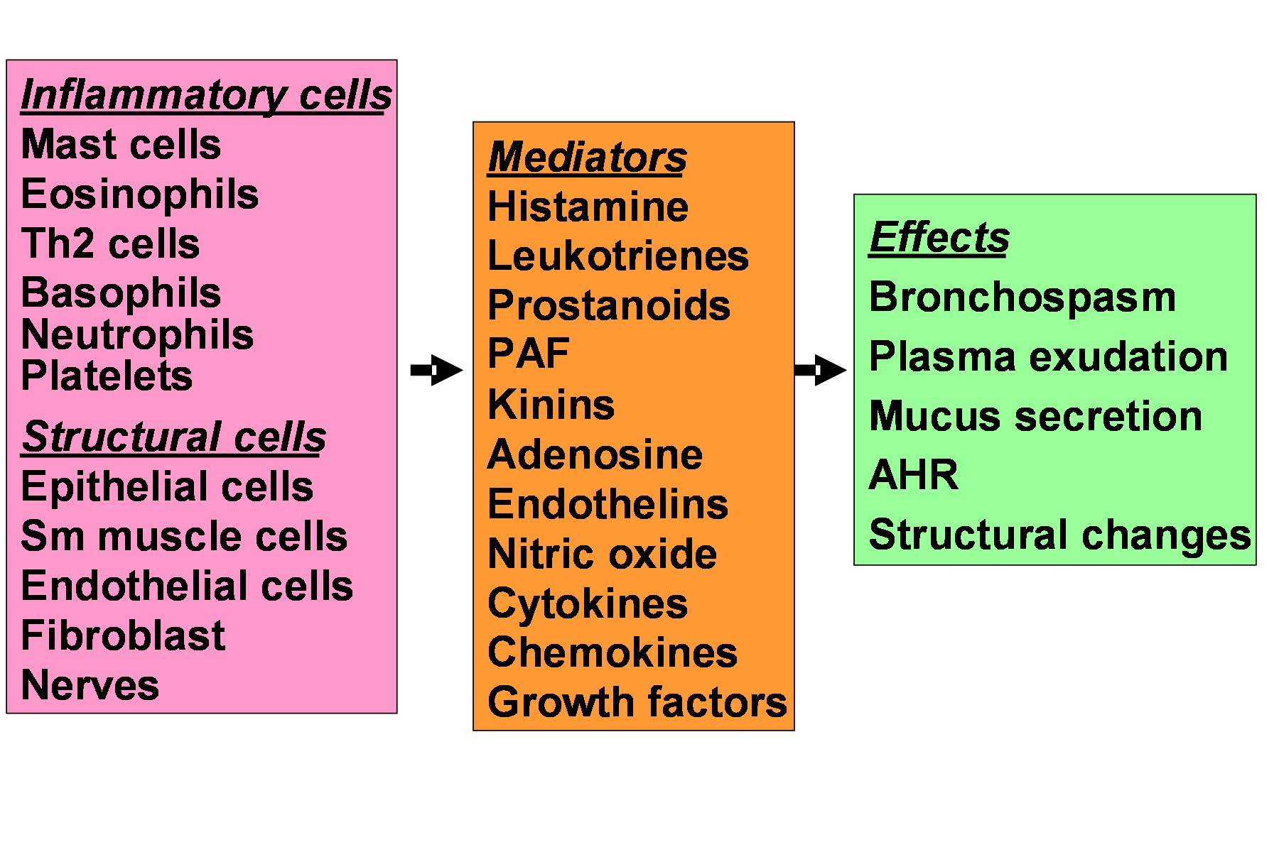
Asthma Inflammation: Cells and Mediators
Source: Peter J. Barnes, MD

Slide 225
_{bronchospasm}
_{brongckb-spazm}
contraction of smooth muscle in the walls of the bronchi and bronchioles, causing narrowing of the lumen.

Slide 226
Typical Spirometric (FEV₁) Tracings
Volume
FEV₁
Normal Subject
Asthmatic (After Bronchodilator)
Asthmatic (Before Bronchodilator)
1
2
3
4
5
Time (sec)
Note: Each FEV₁ curve represents the highest of three repeat measurements

Slide 227
Clinical Control of Asthma
No (or minimal)* daytime symptoms
No limitations of activity
No nocturnal symptoms
No (or minimal) need for rescue medication
Normal lung function
No exacerbations
_________
* Minimal = twice or less per week

Slide 228
Levels of Asthma Control
Characteristic | Controlled (All of the following) | Partly controlled (Any present in any week) | Uncontrolled
Daytime symptoms | None (2 or less / week) | More than twice / week | 3 or more features of partly controlled asthma present in any week
Limitations of activities | None | Any
Nocturnal symptoms / awakening | None | Any
Need for rescue / “reliever” treatment | None (2 or less / week) | More than twice / week
Lung function (PEF or FEV₁) | Normal | < 80% predicted or personal best (if known) on any day
Exacerbation | None | One or more / year 1 in any week

Slide 229
Classification of asthma by clinical features before treatment
intermittent
Symptoms less than once a week
Brief exacerbations
Nocturnal symptoms not more than twice a month
FEV1 or PEF ≥ 80% predicted
PEF or FEV1 variability < 20%

Slide 230
Mild Persistent
Symptoms more than once a week but less than once a day
Exacerbations may affect activity and sleep
Nocturnal symptoms more than twice a month
FEV1 or PEF ≥ 80% predicted
PEF or FEV1 variability < 20 – 30%

Slide 231
Moderate Persistent
Symptoms daily
Exacerbations may affect activity and sleep
Nocturnal symptoms more than once a week
Daily use of inhaled short-acting 2-agonist
FEV1 or PEF 60-80% predicted
PEF or FEV1 variability > 30%

Slide 232
Severe Persistent
Symptoms daily
Frequent exacerbations
Frequent nocturnal asthma symptoms
Limitation of physical activities
FEV1 or PEF ≤ 60% predicted
PEF or FEV1 variability > 30%

Slide 233
TREATMENT
The choice of treatment should be guided by:
Level of asthma control
Current treatment
Pharmacological properties and availability of the various forms of asthma treatment
Economic considerations
Cultural preferences and differing health care
systems need to be considered

Slide 234
Controller Medications
Inhaled glucocorticosteroids
Leukotriene modifiers
Long-acting inhaled β₂-agonists
Systemic glucocorticosteroids
Theophylline
Cromones
Long-acting oral β₂-agonists
Anti-IgE
Systemic glucocorticosteroids

Slide 235
Asthma treatment can be administered in different ways—inhaled, orally, or by injection. The major advantage of inhaled therapy is that drugs are delivered directly into the airways, producing higher local concentrations with significantly less risk of systemic side effects.
Rapid-acting inhaled β2-agonists are the medications of choice for relief of bronchoconstriction and for the pretreatment of exercise-induced bronchoconstriction, in both adults and children of all ages.

Slide 236
Treatment of exacerbations
Primary therapies for exacerbations:
Repetitive administration of rapid-acting inhaled β₂-agonist
Early introduction of systemic glucocorticosteroids
Oxygen supplementation
Closely monitor response to treatment with serial
measures of lung function

Slide 237
Life threatening asthma
Dr KWIZERA NDEKEZI Jackson
Anesthesiologist

Slide 238
Triggers of acute asthma
Air pollutants
Respiratory tract infections (pneumonia)
Allergen exposure
Panic-type anxiety
Allergic rhinitis
Medications (aspirins, NSAIDs, B-blockers, ACE inhibitors)
Sinusitis
Cold: viral infection

Slide 239
Classification
Slow onset of life threatening asthma: onset over days to weeks, copious of mucoid secretions with
Intense eosinophilia infiltration and resistant to bronchodilators
This counts 80%-85% of fatal asthma
Sudden type of asthma: onset over minutes to hours
Acute bronchospasm
Absence of large airways secretions and mucus plug
Eosinophilia infiltration in submucosa
Marked response to bronchodilators
Quick recovery
This is sudden asphyxic asthma

Slide 240
Pathophysiology
Bronchial smooth muscle contraction
Bronchial inflammation associated mucosal edema and mucus plugging
Obstruction of air flow leading to low V/Q areas and hypoxemia
Expiratory obstruction
Decreased force expiratory volume (FEV₁ )
Normal FEV₁ > 3L in men and > 2L in women)
Decreased FEV₁/FVC ratio (75-85%)

Slide 241
Pathophysiology…
In severe asthma, the pt is unable to complete expiration because of expiratory airway resistance, tachypnea induced limited expiration time
Air trapping and increased FRC with decreased FVC
Hyperinflation leads to increased work of breathing
Edema and increased airway secretions also compromises inspiratory flow
High peak inspiratory pressures in mechanically ventilated pt
Respiratory arrest from failure of inspiratory muscles with ventilatory arrest

Slide 242
Signs and symptoms
Expiratory/ inspiratory wheezing (air movement trough airways obstruction)
Absence of wheezing in severely distressed asthmatic pt (minimal air mvt/ respiratory arrest)
Contraction of sternocleidomastoid and other accessory muscles (severe obstruction FEV1 < 1 L)
Pulsus paradoxus (decreased SV during inspiration)
Diaphoresis
Lungs hyperinflation (auto-PEEP)
Significant decreased systemic venous return
Increased pulmonary artery pressure and increased R ventricular afterload

Slide 243
Signs and symptoms…
Altered mental status, confusion and coma
Cyanosis,
silent chest,
hypotension,
bradycardia,
SPO2<92%
PaO2 < 60 mmHg
PaCO2 > 60mmHg
FEV< 30%

Slide 244
Hospitalization’s conditions
Acute respiratory acidosis, despite bronchodilators
Pneumonia
Pneumothorax
FEV1< 25%
Multiple visits to emergency for severe asthmatic attack
H/O intubation or ICU admission because of asthma

Slide 245
Admission to ICU
Respiratory distress
Impending RF
Altered mental status
SPO2 ≤ 90% despite oxygen therapy
Rising PaCO2 with no improvement

Slide 246
Management
Humidified oxygen therapy to maintain SPO2 > 92%
β-Adrenergic agonist:
Inhaled β2 selective agonists (Albuterol or Salbutamol)
Albuterol for acute exacerbation in pt with acute asthma
Dose: 2.5-5 mg (0.5-1 ml of 5% in 5 ml NS) nebulization every 20 minutes for 3 doses
Then, 2.5-10 mg every 1-4 hrs as needed or 10-15mg/hour continuously, titration based on response and severity

Slide 247
Management…
Tachycardia and hypokalemia may occur in continuous nebulized β2-Adrenergic agonists
Parenteral/ oral β2-Adrenergic agonists loose much of β2 selectivity
Metered-dose inhaler (MDI) in acute bronchospsm (4 puffs of albuterol 0.36 mg)
Aerosol β2-agonists delivered in ETT and pt on mechanical ventilation, loose much of physiologic effects due to its deposition on ETT so double the dose.

Slide 248
Management…
Levalbuterol 0.63 mg/3 ml nebulizer solution
Dose: 1.25 - 2.5 mg every 20 minutes for 3 doses,
then 1.25 – 5 mg every 1-4 hours as needed
Or 5-7.5 mg/ hour continuous nebulization

Slide 249
S/C Epinephrine or Terbutaline
In seriously asthmatic pt with risk of respiratory arrest or need of intubation, but with low risk of cardiac toxicity (young asthmatics)
Combination of inhalation and S/C
Epinephrine 1/1000 at 0.3-0.5 ml may be repeated in 20 minutes for 3 times
Or Terbutaline 0.25 mg every 20 min for 3 doses (choice in pregnant)
Epinephrine in ETT after respiratory arrest from asthma

Slide 250
Corticosteroids
IV Methylprednisolone 40-80 mg/day in 1 or 2 doses
Benefit when initiated in early phase of acute asthma
Cause up-regulation of new β2 receptors
Inhaled steroids should be started any time during exacerbation of acute asthma
Duration: 3-10 days

Slide 251
Ipratropium
Effects are additive to albuterol
Multiple high doses of ipratropium in acute severe airflow obstruction resulted in fewer admissions
Dose: 0.5 mg by nebulizer every 2-4 hours
Onset of action is slow (20 minutes),
Peak effects of 60-90 minutes with no systemic side effects
Ipratropium may be combined with albuterol nebulized dose
MDI (0.08mg/puff) 4-8 puffs/ treatment

Slide 252
Methylxanthines: Theophylline or Aminophilline
Additive effects of Theophylline and inhaled B agonists
Methylxanthines are infrequently used in acute asthma

Slide 253
Mechanical ventilation
ETT and mechanical ventilation are indicated in:
Pt with central cyanosis
Altered mental status/ depressed level of consciousness (coma)
Impaired oxygenation and ventilation
Sustained RR> 40 breaths/ minute
Increasing PaCO₂ despite aggressive therapy
Elevated PaCO₂ correlated with FEV1 less than 25%
Respiratory failure evidenced by paradoxical breathing
Largest ETT is the best to decrease the auto-PEEP

Slide 254
Sedation and analgesia
Sedation and analgesia are always required in preparation of intubation
Sedation and analgesia should be avoided in non-intubated asthmatic pt
Once, pt intubated and on mechanical ventilation, benzodiazepines or propofol and opioids
NMBAs to control RR in life threatening auto-PEEP
Status asthmaticus on MV and receiving corticosteroids and NMBAs are at risk of prolonged muscles weakness after discontinuation of NMBAs
If NMBAs are needed, cisatracurium is the best ( elimination by esterase degradation)
Stop NMBAs as soon as possible

Slide 255
Mechanical ventilation
Avoid excessive airways pressures and reduce hyperventilation
Allow controlled hypoventiltion/ permissive hypercapnia
Initial: TV 8 ml/kg, RR: 10-14 breaths/min, MV:< 10 L/minute
Increased expiratory time to avoid auto-PEEP, which can cause barotrauma, pneumothorax, increased intra-thoracic pressure, decrease of cardiac output and hypotension
To achieve SPO2> 90%
Peak inspiratory rates: 60-80 L/ minute
TV can be reduced to achieve inspiratory plateau of 30 cmH₂O or less
Minimize hyperventilation by I:E ≤ 1:3

